Slide 1
Anatomy of a Git Project
Victor Grazi – VP – Enterprise Infrastructure
New York, NY
Notes:
A lot of people are migrating to Git from other version control systems like SVN. And there are differences. Today I don't want to talk about SVN, Github, Gitlab, I just want to talk about Git. Let's see what the main commands are, see what it is doing under the covers, and see how we can manage our projects in Git.

Slide 2
Agenda
Git Basic Concepts
What is Git?
Branching/Merging/Rebasing
Git Right to Left Workflow
Git Left to Right Workflow
Anatomy of a Git Project
Branching Strategies

Slide 3
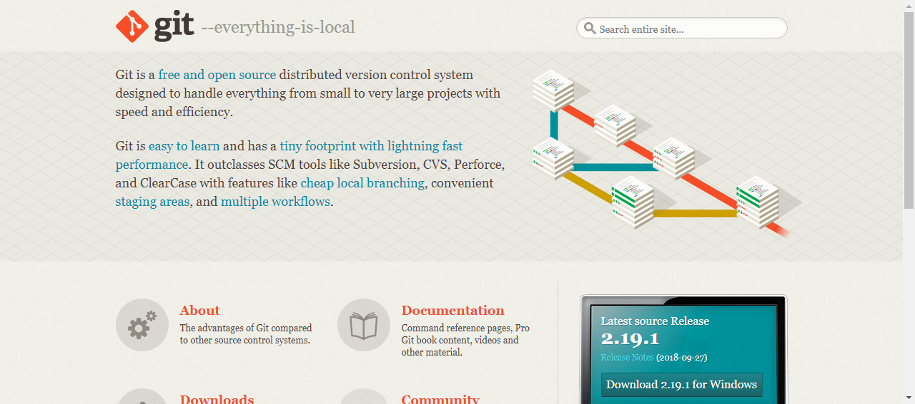
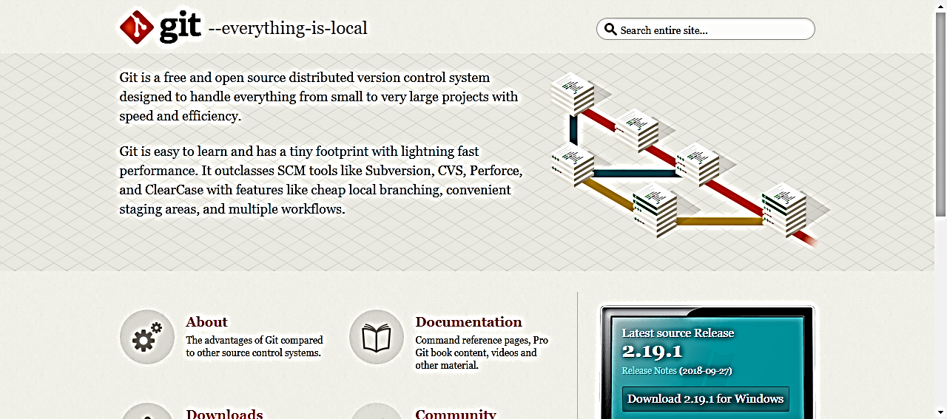
Everything is Local!!

Slide 4
Getting to Know Git
SVN projects:
local workspace
and remote repository.
git init creates a fully functional local repo.
Git remote & local clones look exactly alike.
Notes:
If you are from the SVN world, you have a local workspace and a remote repository for each project.
In your local directory, you have a lot of .svn directories.
Git is much different. There is no difference between the structure of the remote machine and your local clones. (Any local git repo can be a remote as well) If you create a git repo on your machine, someone else can access your machine and check out and commit.
You don’t even need a remote at all, you can just use
git init to create a local Git repo
There are three areas in a Git local repo:
Working area
Staging area (or Index)
Repository
There is one HEAD, that points to the branch where your commits and checkouts will occur.
Every local git command either moves data between the areas or moves the current head

Slide 5
Getting to Know Git
Three areas in a Git local repo:
Working area
Staging area
Repository
Git commands either:
Move data between these areas. Or
Move the current “HEAD” pointer. Or
Run a report
Notes:
There is one HEAD, that points to the branch where your commits and checkouts will occur.
Every local git command either moves data between the areas or moves the current head

Slide 6
Git – Common Left to Right Workflow
Working area | Staging Area | Repository (local) | Remote (origin)
Legend
> git commit -m “message”
# commit staging area to repository
(git commit –a –m “message” is the same as git add, followed by git commit)
-
Untracked
> git init # create a local repository
<< create or edit your files >>
> git add . # copy files to staging area
(git rm --cached <file> # opposite of git add)
Uncommitted
Committed
> git push # push the commit to the remote
Notes:
Once you do an init, you can start versioning anything under that directory. No need for a remote

Slide 7
Git – clone
Working area | Staging Area | Repository (local) | Remote (origin)
Legend
> git clone <<url from host>>
Untracked
-
Uncommitted
# init local repo
# and copy remote to local
Committed
Notes:
Using git clone, an exact replica of the remote machine will appear on your local machine, fully initialized

Slide 8
Git – checkout
Working area | Staging Area | Repository (local) | Remote (origin)
Legend
Untracked
Legend
Uncommitted
Committed
Untracked
> git checkout <branch>
Uncommitted
-
Committed
# copy branch to working area
Notes:
Once you do an init, you can start versioning anything under that directory. No need for a remote

Slide 9
Git - What’s a commit?
A commit consists of:
“Blob” objects for each file in that commit
A ”Tree” object pointing to those blobs,
A “Commit” object that points to that tree

Slide 10
What goes into a commit?
Commit crunches
File content
Commit date
Parent-commit references
Your commit comments
and produces a SHA-1 hash code, which is a key into the Git database
e.g. 1d97b9a335ec

Slide 11
Git - What’s a commit?
commit .
parent .
tree .
author .
.
92ec21
639a1c
1d97b9
vgrazi
tree .
blob .
blob .
1d97b9
21f3c1
f50231
blob . file .
21f3c1
content1
blob . file .
f50231
content2
$ git cat-file –p 92ec21
tree 1d97b9a335ec
parent 639a1cde8e
author Victor Grazi
committer Victor Grazi

Slide 12
What’s a commit?
021e638 Oct 19 12:51 vgrazi: done!
master
HEAD
bf1599d Oct 17 12:49 jjones: almost
master
HEAD
a641e01 Sep 15 12:46 mlamb : stuff
master
HEAD
9aca92f Aug 21 12:42 vgrazi: more
master
HEAD
6e33d1c Aug 17 12:21 ismith: change
master
HEAD
fed59d6 Jul 17 11:45 vgrazi: initial
master
HEAD

Slide 13
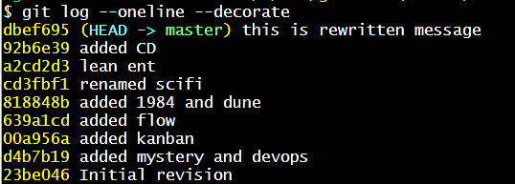
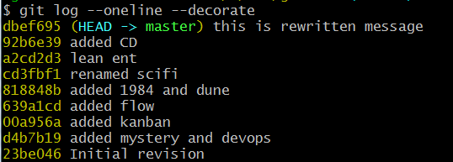
What’s a branch?
git branch my-branch # create a branch
A branch is simply a pointer to a commit.
(HEAD points to the current branch)
Notes:
because a branch is just a pointer, it is very cheap to create and destroy.
This should encourage developers to do so often
Give your branches a name that include both your JIRA and a brief description

Slide 14
What’s a branch?
A branch is simply a pointer to a commit.
(HEAD is just a pointer to the current branch)
Default branch is called “master”
fe1632
my-branch
HEAD
git branch my-branch
git checkout master
git checkout my-branch
git checkout other
932f60a
other
HEAD
021e638
my-branch
HEAD
a641e01
master
HEAD
other
HEAD
3f1509d
bf1599d
my-branch
HEAD
9aca92f
master
HEAD
6e33d1c
master
HEAD
de159d6
master
HEAD
Notes:
fix animation sequence

Slide 15
Git – Soft Reset
Working area | Staging Area | Repository (local) | Remote (origin)
> git reset --soft <commit# or branch or HEAD>
# moves the HEAD pointer for the current branch # to the specified commit # Does not touch staging or working areas
-
Legend
Untracked
Uncommitted
Committed
Notes:
Once you do an init, you can start versioning anything under that directory. No need for a remote

Slide 16
Git – Mixed reset
Working area | Staging Area | Repository (local) | Remote (origin)
> git reset <commit# or branch or HEAD>
# copy commit to staging but not to working area # issues no warning
# (-- mixed is default)
-
Legend
Untracked
Uncommitted
Committed
Notes:
Once you do an init, you can start versioning anything under that directory. No need for a remote

Slide 17
Git – hard reset
Working area | Staging Area | Repository (local) | Remote (origin)
Legend
Untracked
> git reset --hard <commit# or branch or HEAD>
Uncommitted
Committed
> # copy the commit to staging and
> # working areas, and moves > # HEAD pointer to that commit
> # issues no warning
-
Legend
Untracked
Uncommitted
Committed
Notes:
Once you do an init, you can start versioning anything under that directory. No need for a remote

Slide 18
-
Git – fetch / merge / pull
Working area | Staging Area | Repository (local) | Remote (origin)
> git fetch
# update from remote to local. HEAD ptr unchanged
> git merge
Legend
# merges the commits and
Untracked
# advances the HEAD pointer
Uncommitted
<< git pull == git fetch + git merge >>
Committed

Slide 19
Merging branches creates a new commit
CO
C1
C2
C4
C6
C3
C5
> git merge --no-ff

Slide 20
Merge
Rebase
’
’
’
m5
Warning! Never rebase a shared commit
v3
m4
v3
m4
v3
v2
Time
v2
m3
m3
v2
v1
v1
m2
v1
m2
m1
m1
master
other
master
other
git checkout other
git merge master
git checkout other
git rebase master

Slide 21
Some Reporting Commands
git status # most useful status report
git log --oneline # displays a git log
git diff --cached # diff working with stage
gitk # display a UI
git ls-tree --r master --name-only # Lists tracked files
git cat-file -p # Un-hashes sha-1 hash code

Slide 22
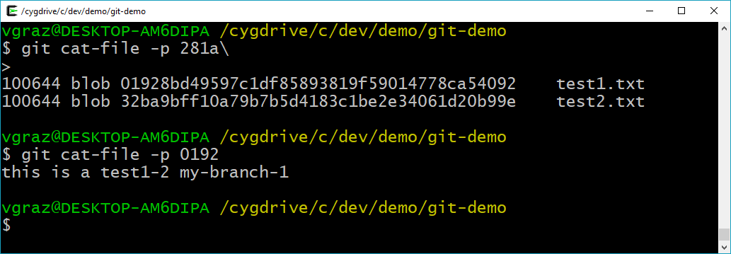
Demo

Slide 23
Part 2
Git Branching Strategies

Slide 24


Sir you’re parked in a no parking zone!
Works every time!

Slide 25
Continuous Integration Timeline
Prehistorically – Developers manually built code and delivered it to a human integrator
every 3 months integrator would manually ”integrate” everyone’s work
a grueling, tortuous process!
1994 – Grady Booch writes Object-Oriented Analysis and Design with Applications
uses the phrase “continuous integration” to explain how "internal releases represent a sort of continuous integration of the system"
1997 – Kent Beck and Ron Jeffries invented Extreme Programming (XP) while on the Chrysler Comprehensive Compensation System project, including continuous integration
1999 – Beck elaborates on continuous integration in his first full book on Extreme programming, emphasizing importance of face-to-face communication
2001 – CruiseControl released - the first CI/Build server
2005 – Linus Torvalds creates Git while developing Linux to address SVN shortfalls
2009 – Martin Fowler publishes his popular blog posting on feature branching https://martinfowler.com/bliki/FeatureBranch.html
2012 – Vincent Driessen introduces Gitflow

Slide 26
Git branch commands
$ git branch -v scifi 93b412c fix javascript issue
* master 7a98805 Merge branch ‘scifi'
testing 782fd34 add f451
Branches without a ‘*' are fully merged and may be deleted safely

Slide 27
Cherry-pick
’
’
’
Under Construction
v3
m4
v2
Time
m3
v1
m2
m1
master
my-branch
$ git checkout my-branch
$ git rebase master

Slide 28
Why Branch?
Scenario 1
You’re building a new application feature
Do some work on a feature
Create a branch for that feature
Do more work on that branch
Stuff happens…. need to fix a critical prod issue
Checkout prod branch
Create a branch for the fix
Test, merge, release
Switch back to the feature branch and continue

Slide 29
Why Branch?
Scenario 2
You’re working on a feature,
you don’t want to push it to mainline until it is relatively stable,
but you do want to commit frequently.

Slide 30
Requirements of Collaborative Development
Everyone commits to the mainline every day. (The fundamental rule of continuous integration)
Resolve code conflicts early
Beware of different branches generating the same snapshot version
Remember – Git is not just a VCS, it is a development tool

Slide 31
Which Branching Strategy? Decision points
Does you current strategy work? If it ain’t broke, don’t fix it!
otherwise…. consider – what’s broken, make small changes then look again!
Number of active versions
Team size
Degree of collaboration
Regional distribution
Volatility
Modularization of codebase

Slide 32
Centralized Work (no branches)
master
Create Release Tag 1.0.0
Time
Create Release Tag 1.0.1
Create Release Tag 1.1.0
Jenkins
Notes:
This is a great approach for a large development team that is coming off of SVN, and has not yet become accustomed to the simplicity of Git branching.
It has the following merits
Developers know they have to commit frequently
You never fall behind because you pull very frequently (i.e. before every commit!)
Conflicts are detected early, which is the easiest time for them to be corrected
Developers know that their commits are impacting everyone so it promotes good citizenship
You get continuous integration, there is no confusion about build versions
Downside
Everything is comingled, so it is difficult to review your own feature changes in isolation
There is no feature segregation, so you can’t easily decide which features to include in the next release and which to defer.

Slide 33
Merits
Familiar to teams coming off SVN
Developers commit frequently
Pull very frequently – conflicts detected early
Master always stable – good citizenship
CI, no confusion about versions
Downside
Difficult to maintain different versions concurrently
Everything is comingled, difficult to review feature changes in isolation
No feature segregation, difficult to decide which features to include in release.
Centralized Work (no branches)

Slide 34
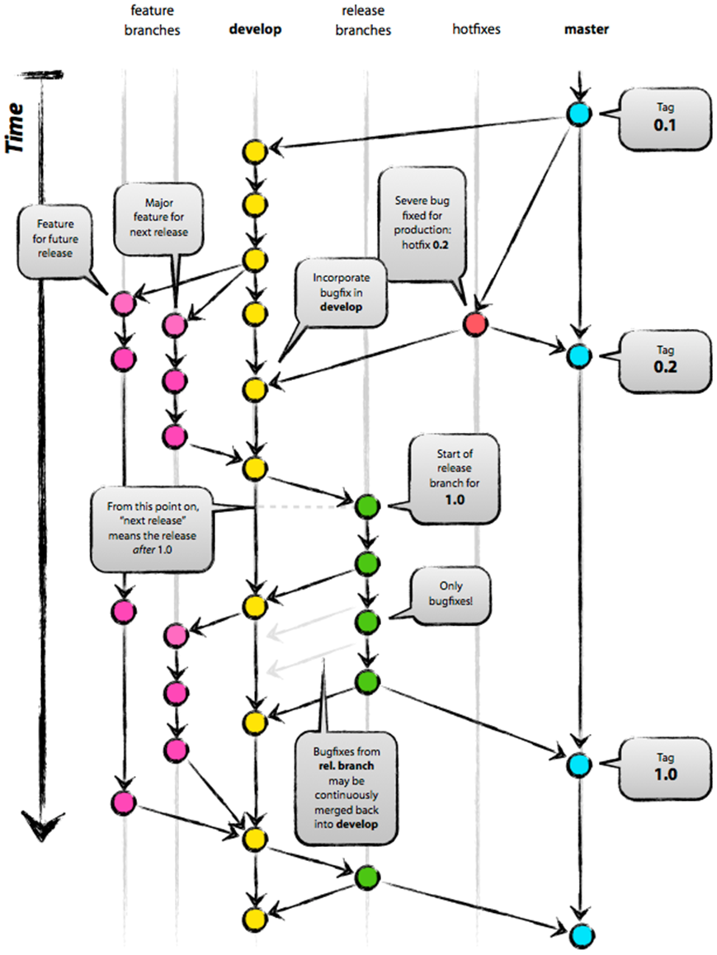
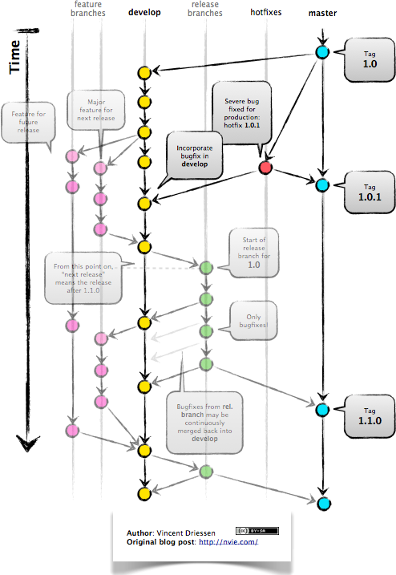
GitFlow - by Vincent Driessen - January 2012
http://nvie.com/posts/a-successful-git-branching-model/
1.0.1
1.1.0
1.1.0

Slide 35
feature
branches
develop
(unstable)
release
branch
master
(stable)
hotfixes
Major feature for next release
Start of release branch for 1.1.0
Feature for future release
Create Tag 1.1.0
(Patch release)
Create Tag 1.1.1
(Patch release)
Time
Severe bug fixed hotfix 1.1.1
Bug fixes go directly on ‘release’
Bug fixes from ‘release’ are continuously merged back into ‘develop’
Jenkins
snapshots
Jenkins
releases
Gitflow
34
Notes:
Master tracks the official release history. When you start, branch a develop branch off master
Develop is “unstable”, an integration branch for new features
When a feature is complete, merge it back into the develop branch
When it is time for a release, a release branch is created from develop
UAT testing is performed on the release
Then continue to build, deploy and fix until happiness
Creating and resetting branches are easy!
Challenges with this approach:
Builds aren’t configured to run on feature branches.
Conflicts materialize on the develop branch, and you won’t notice them until you pull and merge the feature.

Slide 36
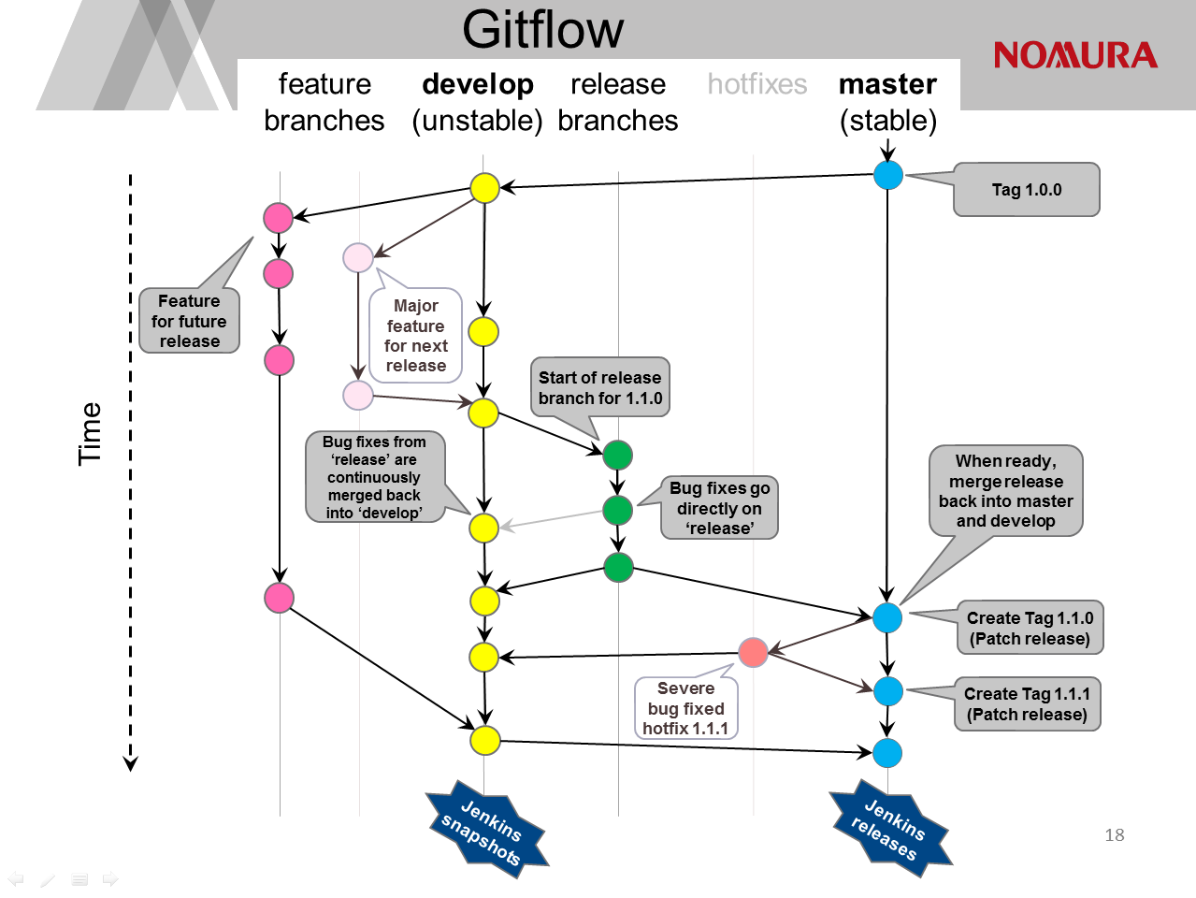
Notes:
Master tracks the official release history. When you start, branch a develop branch off master
Develop is “unstable”, an integration branch for new features
When a feature is complete, merge it back into the develop branch
When it is time for a release, a release branch is created from develop
UAT testing is performed on the release
Then continue to build, deploy and fix until happiness
Creating and resetting branches are easy!
Challenges with this approach:
Builds aren’t configured to run on feature branches.
Conflicts materialize on the develop branch, and you won’t notice them until you pull and merge the feature.

Slide 37
Gitflow
Merits
Features are isolated – easy to manage your own feature changes in isolation
Easy to maintain different versions
Feature segregation, lets you decide which features to include in release.
Downside
Changes maintained on feature branches, hard to do continuous integration
Or you build snapshots off every feature branch, causing ambiguous binaries for a given pom version
Notes:
Master tracks the official release history. When you start, branch a develop branch off master
Develop is “unstable”, an integration branch for new features
When a feature is complete, merge it back into the develop branch
When it is time for a release, a release branch is created from develop
UAT testing is performed on the release
Then continue to build, deploy and fix until happiness
Challenges with this approach:

Slide 38
Summary
Git branching is simple, collaboration is not
If what you’re doing works, stay with it
If not, tweak it, try it, and revise as necessary
Remember the rules:
Merge to master often to minimize conflicts
Integrate often
Keep your mainline “master” stable!
Don’t let different branches generate the same snapshot version

Slide 39
More Information
Git documentation: https://git-scm.com/doc
http://github.com/nvie/gitflow
https://www.atlassian.com/git/tutorials/comparing-workflows
https://martinfowler.com/bliki/FeatureBranch.html

Slide 40
Git - Initial setup
Install Git client from AMS: Git_Git-Gui-x64_2.15.1_EN_01
Generate SSH keys: https://gitlab.nomura.com/help/ssh/README
To create a new project in GitLab, create a Service Now ticket http://intranet.nomuranow.com/RFB/RFBController?action=viewRFBForm&FORM_ID=RF000008634
For more information, see DevOps Git Tactical Playbook: http://gm-dev-tools.nomura.com/ETCB/confluence/display/DEVOPS/Playbook+-+GitLab
Optimizations for Git Bash slowness: https://blog.praveen.science/solution-to-git-bash-is-very-slow-in-windows/
git config --global core.preloadindex true
git config --global core.fscache true
git config --global gc.auto 256

Slide 41
Global Settings
https://blog.praveen.science/solution-to-git-bash-is-very-slow-in-windows/
git config --global --list
git config --global\ perfomance core.preloadindex true
git config --global \
core.fscache true
git config --global gc.auto 256
git config --global \
core.safecrlf false\ \
# turn off crlf warning

Slide 42
Anatomy of a Git Project
Q
&
A
Questions???

